Slide 1

BIDIRECTIONAL VISITOR
21AIE114
PRINCIPLES OF MESAURMENTS AND SENSORS
PRESENTED BY
RUCHITH BALAJI - BL.EN.U4AIE21017
B SAI ABHISHEK - BL.EN.U4AIE21015
CHILLAKURU HARI - BL.EN.U4AIE21038

Slide 2
COMPONENTS
ARDUINO UNO R3
LCD (16*2)
POTENTIOMETER
RESISTORS
LED
PIR SENSOR
PIEZO

Slide 3
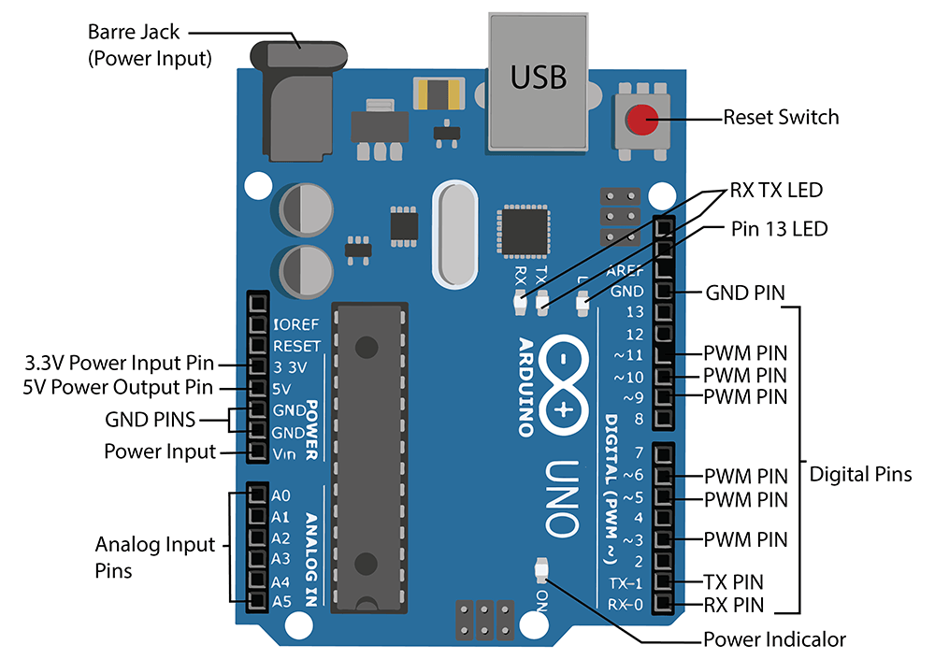
ARDUINO UNO R3
The Arduino Uno board is a microcontroller based on the ATmega328. It has 14 digital input/output pins in which 6 can be used as PWM outputs.
It also have 6 analogue I/O pins.

Slide 4
ARDUINO UNO R3
Features of Arduino:
It is an easy USB interface. This allows interface with USB as this is like a serial device.
The chip on the board plugs straight into your USB port and supports on your computer as a virtual serial port.
The benefit of this setup is that serial communication is an extremely easy protocol which is time-tested and USB makes connection with modern computers and makes it comfortable.
It is easy-to-find the microcontroller brain which is the ATmega328 chip. It has more number of hardware features like timers, external and internal interrupts, PWM pins and multiple sleep modes.

Slide 5
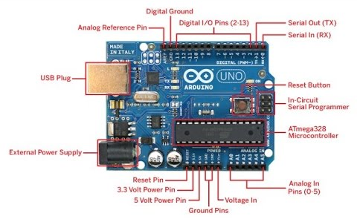
)Specifications
It is an ATmega328P based Microcontroller
The Operating Voltage of the Arduino is 5V
The recommended input voltage ranges from 7V to 12V
The i/p voltage (limit) is 6V to 20V
Digital input and output pins-14
Digital input & output pins (PWM)-6
Analog i/p pins are 6
DC Current for each I/O Pin is 20 mA
DC Current used for 3.3V Pin is 50 mA

Slide 6
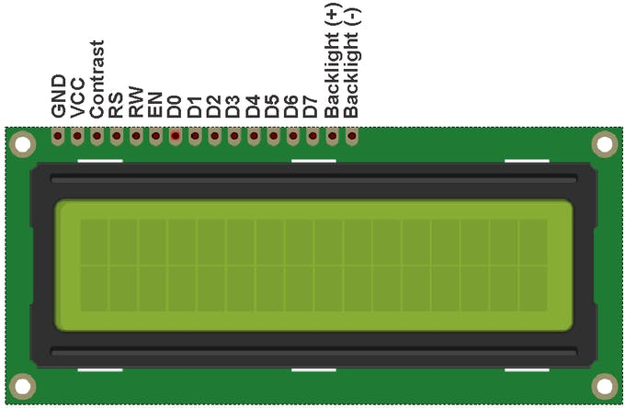
LCD (16 x 2)
An electronic device that is used to display data and the message is known as LCD 16×2.
As the name suggests, it includes 16 Columns & 2 Rows so it can display 32 characters (16×2=32) in total & every character will be made with 5×8 (40) Pixel Dots.
Number of LCD pins – 16

Slide 7
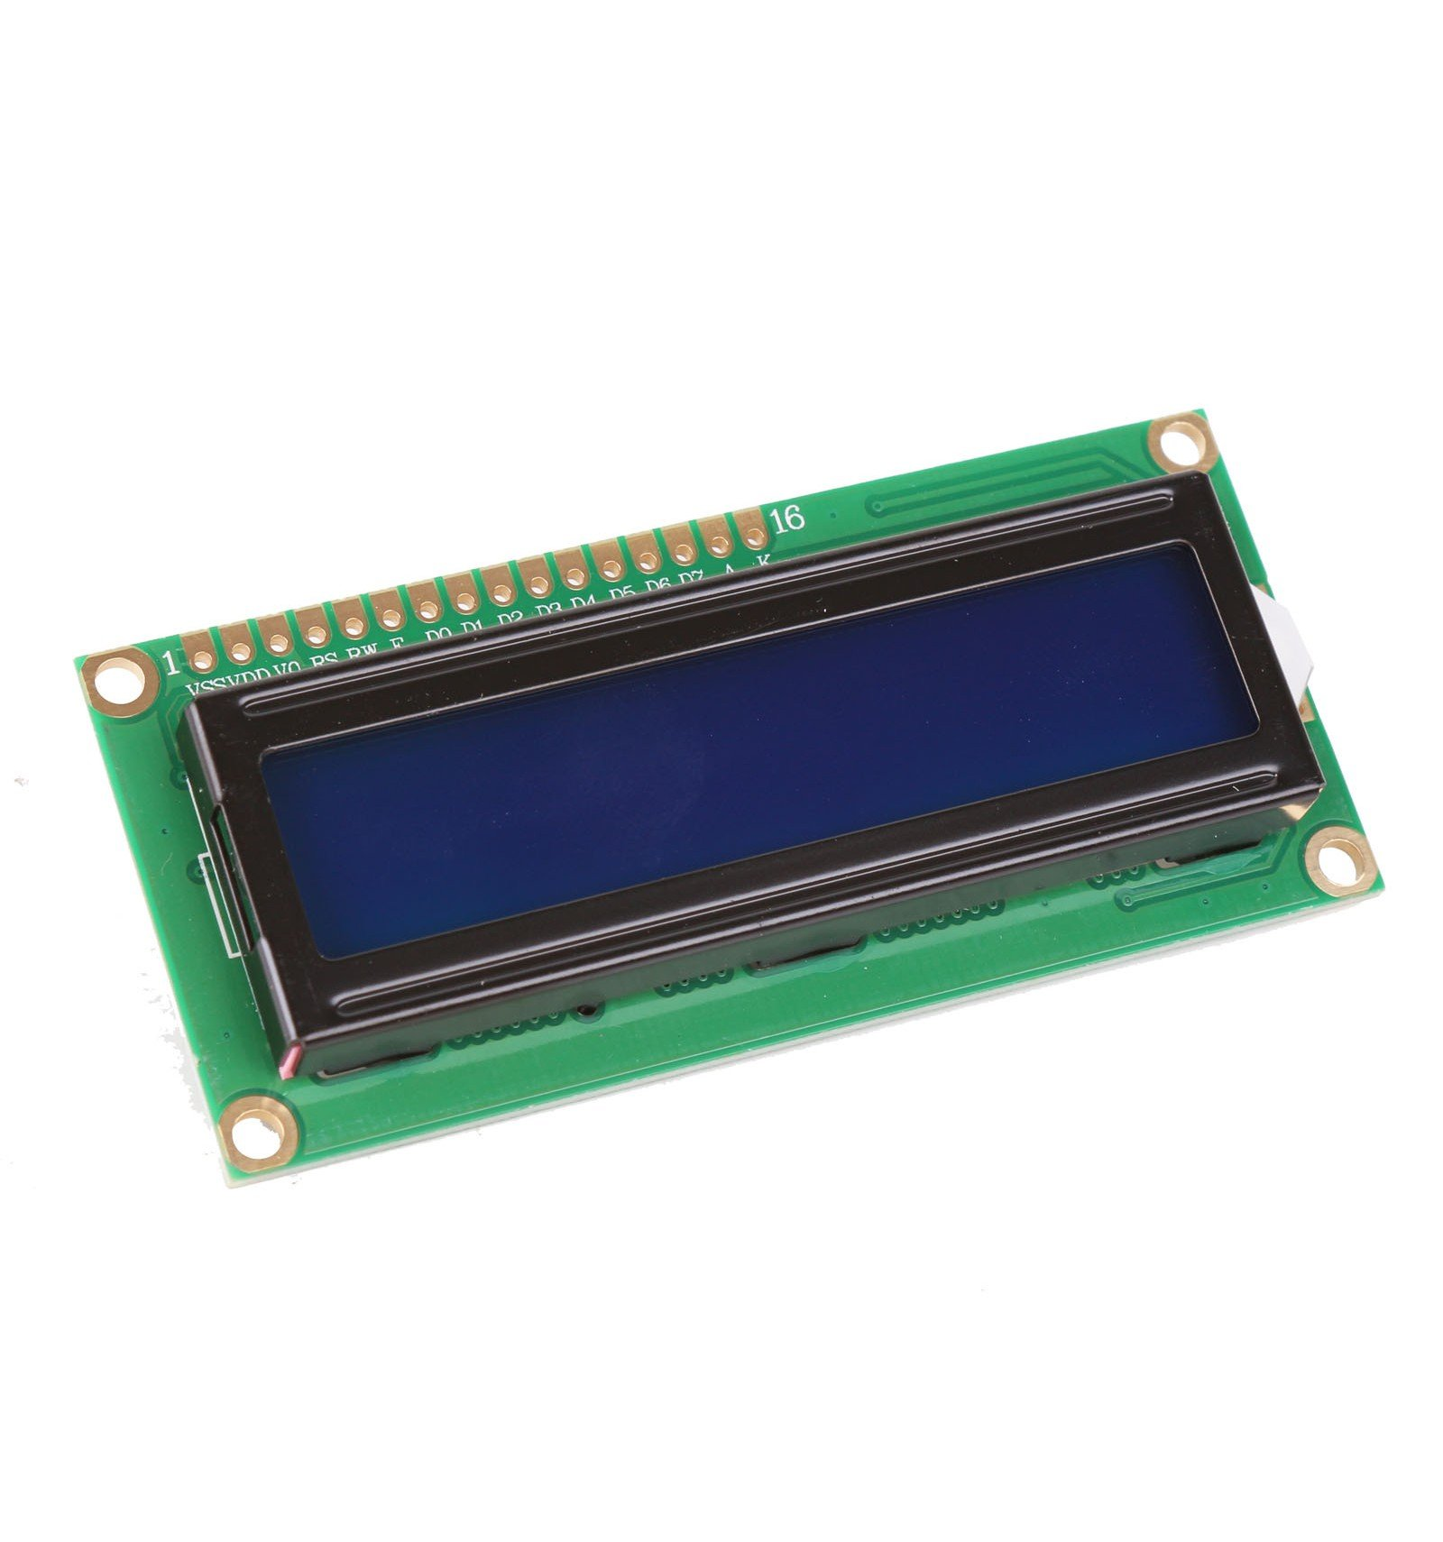
)Specifications
LED color for backlight is green or blue
Number of columns – 16
Number of rows – 2
Number of LCD pins – 16
Characters – 32
It works in 4-bit and 8-bit modes
Pixel box of each character is 5×8 pixel
Font size of character is 0.125Width x 0.200height

Slide 8
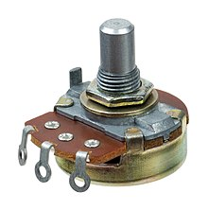
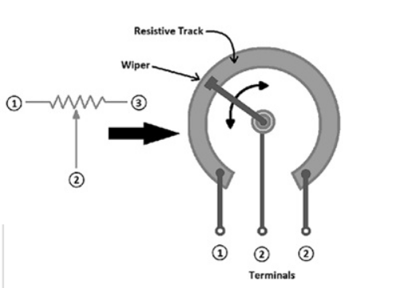
POTENTIOMETER
A potentiometer is a three-terminal resistor with a sliding or rotating contact that forms an adjustable voltage divider.
In this three-terminal device in which one end is called an end terminal and the other two ends are main terminals that are internally connected together.
The resistance between the main terminal remains constant and the end terminal’s resistance can be adjusted with a sliding contact that moves along an axis between the main terminals.

Slide 9
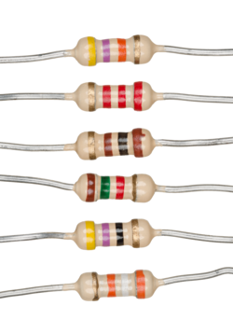
RESISTOR
Resistor is a two-terminal electrical and electronic component that is used to restrict the flow of current within the circuit is known as a resistor.
Resistors are essential components in electrical and electronic circuits which are used in different electronic devices.
The resistors which have high resistance values can be represented through kilo-ohms (K) & Meg ohms (M).

Slide 10
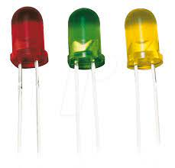
LED
The light-emitting diode definition is, an LED or light-emitting diode is a PN junction diode that produces light once electric current supplies throughout it in the forward direction.
More energy efficient
Long life
It operates at low temperature
Energy usage is low

Slide 11
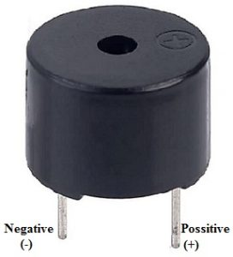
PIEZO Buzzer
An audio signaling device like a beeper or buzzer may be electromechanical or piezoelectric or mechanical type.
The main function of this is to convert the signal from audio to sound.
The pin configuration of the buzzer is shown in Figure. It includes two pins namely positive and negative.

Slide 12
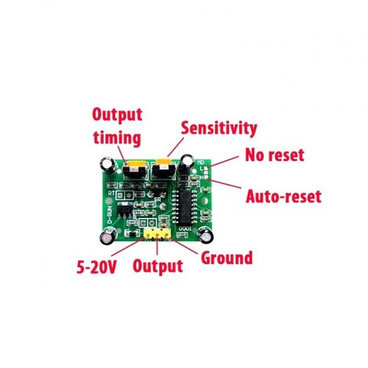
PIR SENSOR
An electronic sensor used for measuring the infrared light radiation emitted from objects in its field of view is called as a PIR sensor or Pyroelectric sensor.
PIR sensors mostly used in PIR-based motion detectors. Also, it used in security alarms and automatic lighting applications.
If a body movement is present near the door, then infrared radiation emitted from the body will cause the sensor to produce sensing signal which is fed to microcontroller.

Slide 13
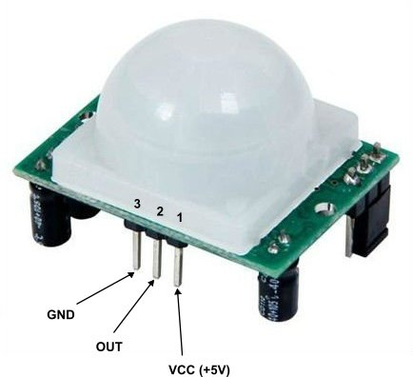
Pin Configuration:
Pin1 corresponds to the drain terminal of the device, which connected to the positive supply 5V DC.
Pin2 corresponds to the source terminal of the device, which connects to the ground terminal via a 100K or 47K resistor. The Pin2 is the output pin of the sensor. The pin 2 of the sensor carries the detected IR signal to an amplifier from the
Pin3 of the sensor connected to the ground.
Fresnel lens used as a focusing system for infrared radiation.

Slide 14
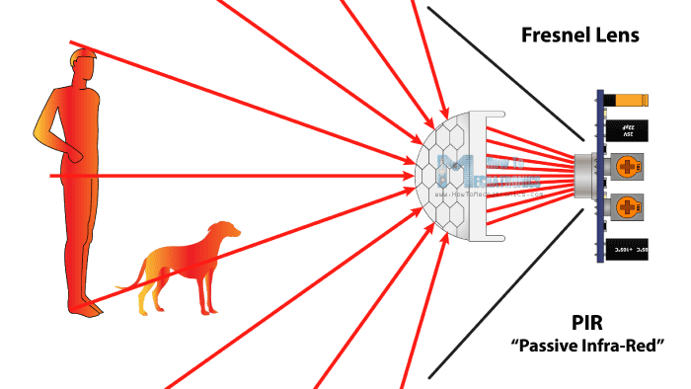
What does a PIR Sensor detect?
PIR sensor can detect animal/human movement in a requirement range.
PIR is made of a pyroelectric sensor, which is able to detect different levels of infrared radiation. The detector itself does not emit any energy but passively receives it.
It detects infrared radiation from the environment. Once there is infrared radiation from the human body particle with temperature, focusing on the optical system causes the pyroelectric device to generate a sudden electrical signal.

Slide 15
PIR Sensor Working Principle:
The passive infrared sensor does not radiate energy to space.
It receives the infrared radiation from the human body to make an alarm.
Any object with temperature is constantly radiating infrared rays to the outside world. The surface temperature of the human body is between 36° C - 27 ° C
Sensor converts human infrared radiation into electricity ,so that it outputs a corresponding signal, which is the alarm signal.

Slide 16
Range of PIR Sensors
Indoor passive infrared: Detection distances range from 25 cm to 20 m.
Indoor curtain type: The detection distance ranges from 25 cm to 20 m.
Outdoor passive infrared: The detection distance ranges from 10 meters to 150 meters.
Outdoor passive infrared curtain detector: distance from 10 meters to 150 meters

Slide 17
WORKING
In this project, two PIR sensors have been used to keep track of the entry and exit of the persons.
Whenever any person passes through sensor 1 and later sensor 2, it will be treated as entry and count will be incremented.
Similarly, if any person passes through sensor 2 and later sensor 1, it will be treated as exit and count will be decremented.
After every entry and exit the buzzer makes sound and message will be displayed.

Slide 18
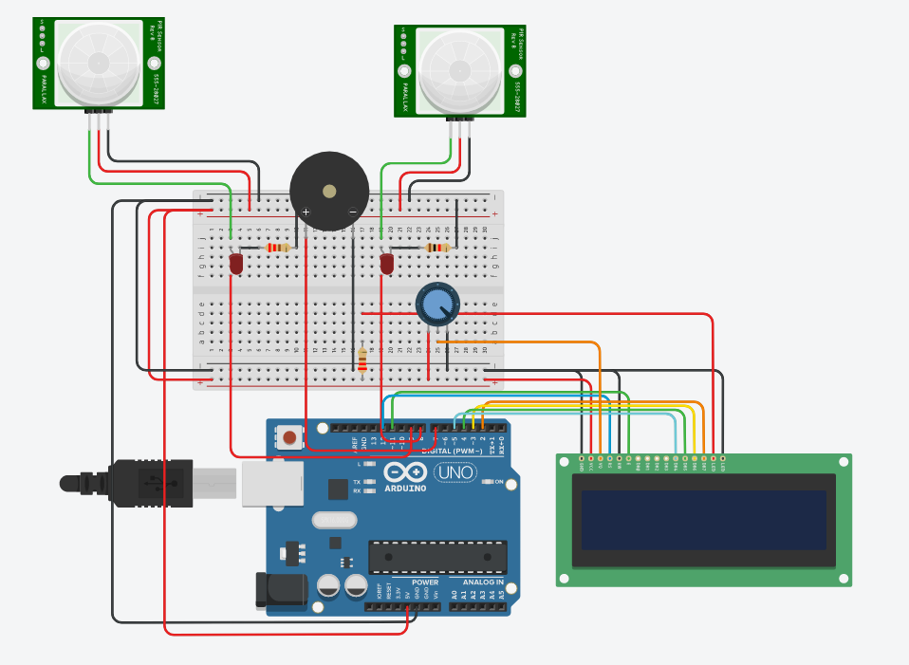
CIRCUIT

Slide 19
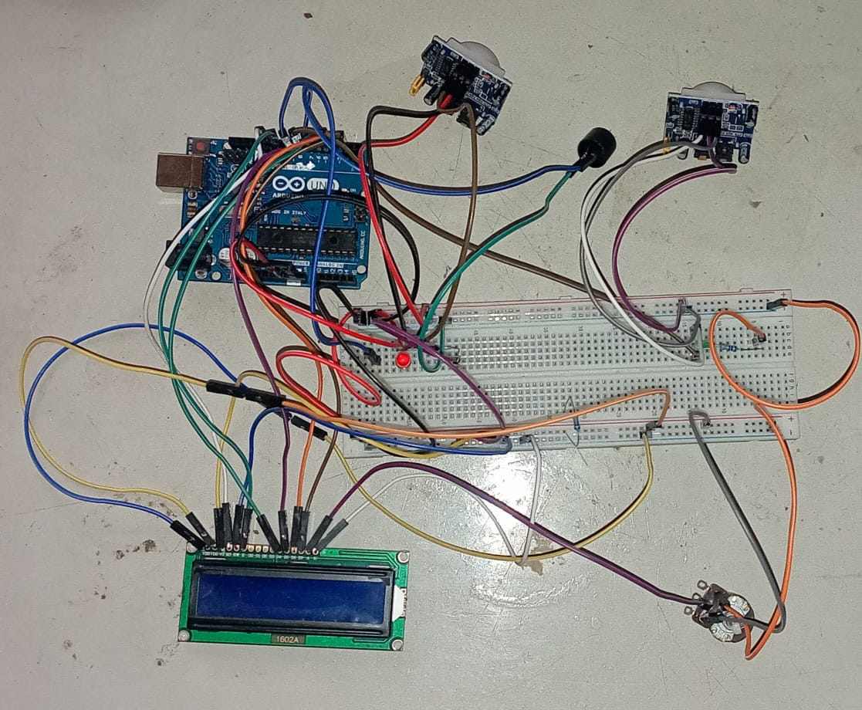
Hardware design:

Slide 20
Conclusion:
Finally, we conclude that the proposed system will count visitors effectively and efficiently by reducing the rate at which error occurs when counting visitors.
As the project was to design and construct a device that would count and display the exact number of people in a building, the following recommendation however should be considered to ensure effective operation of the digital bidirectional visitor counter

